Slide 1



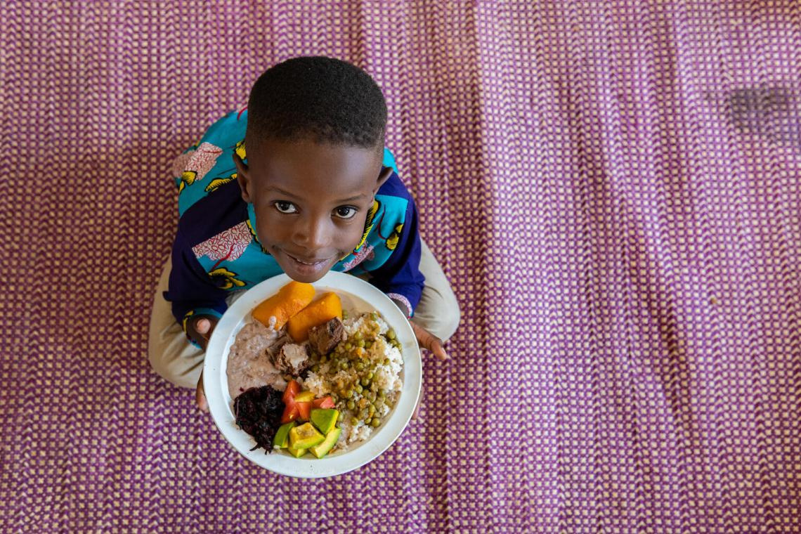


Project
Yugavrittāh
serve the needy

Slide 2
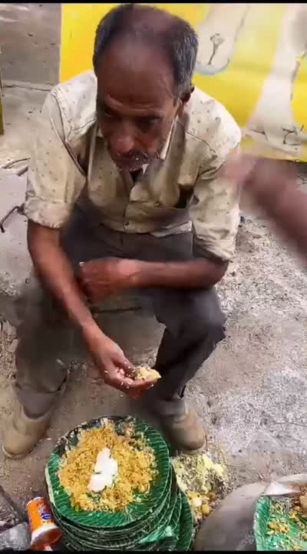
Beginning of the story
Krishna once said “Āhāradānaṁ dharmadānam” which means “Giving food is a righteous donation”

Slide 3
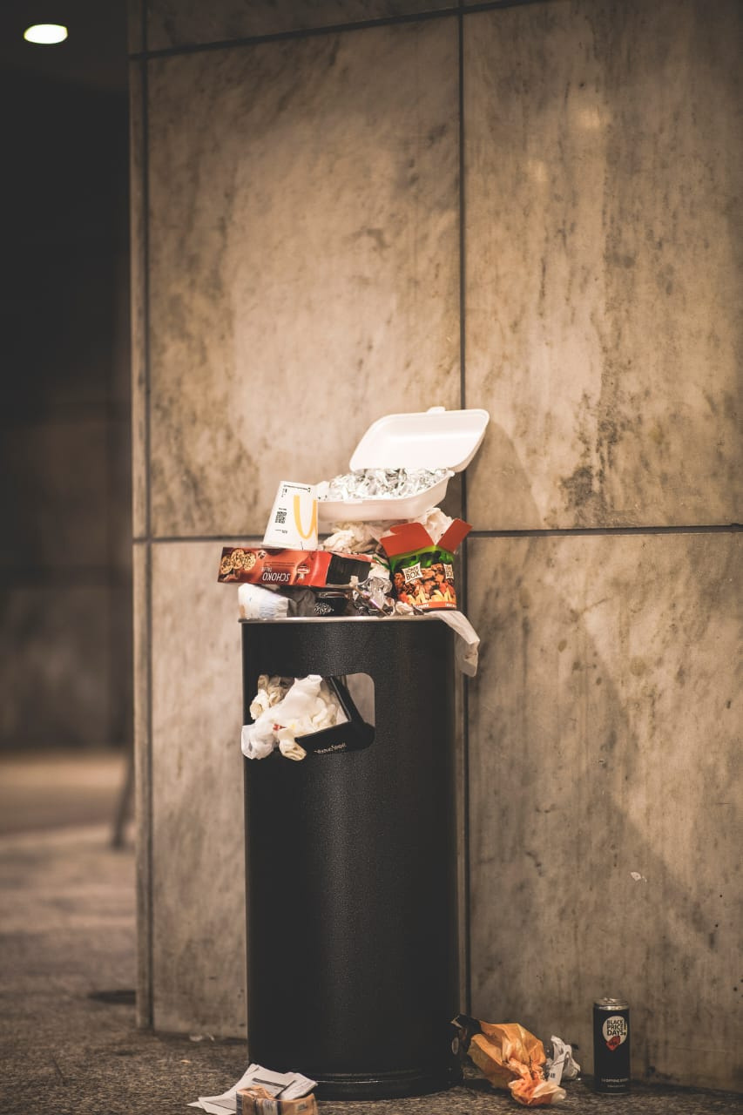


Introduction
Hunger is a global problem that affects millions of people. Roadside people are one of the most vulnerable populations when it comes to hunger. They often lack access to food, shelter, and other basic necessities.
This project is a student-led initiative to feed roadside people in a unique and effective way.

Slide 4



Do you know ?
A 2021 study by the World Resources Institute (WRI) found that India wastes an estimated 40% of its food each year. This wasted food could feed hundreds of millions of people.

Slide 5


Think about it
The real problem lies in the contrast between those who waste food due to excess and those who cannot afford it. Why not seek a solution to bridge this gap ?

Slide 6

The solutiom
Our website connects willing donors with those in need. Users register, and our dedicated volunteers collect food donations from your location, distributing them to the homeless and impoverished communities in a meaningful way.

Slide 7


What’s the Uniqueness?
It's a student-led initiative
It's the first college in Coimbatore to implement this project
Excellent time management skills have been employed

Slide 8

Volunteers
Volunteering is a great way for students to give back to their community, learn new skills, and make a difference in the world.
We plan the Volunteers to schedule their route ahead of time and make sure to communicate it to a staff member or friend.
This will help to ensure that they are taking a safe route and that someone knows where they are going.

Slide 9
Be on time
We use calculation to determine the timing of food distribution, based on the food count information collected from the user.
We survey users to calculate the shifting time for volunteers and the serving time for roadside people.

Slide 10
Rules
Volunteers must complete the food distribution process within the calculated time which will be visible in their phone
The requested food will be collected only if the count of food is greater than 20
Only food that is cooked within 4 hours of the distribution time will be used.
Food will be collected from within a 10-kilometer radius of the college.

Slide 11
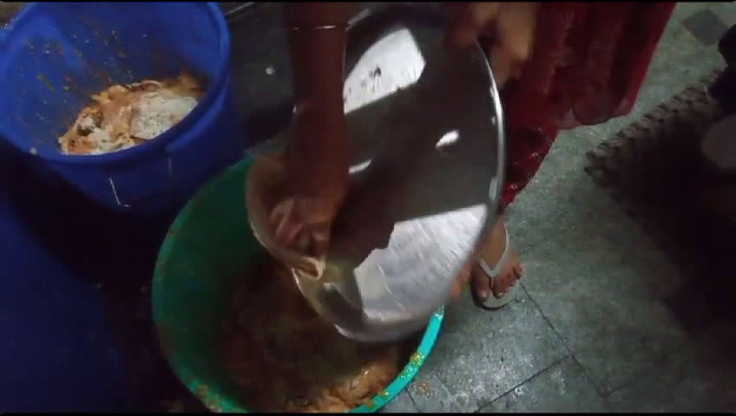
Where to
start
?

Slide 12




Ignite through innovation
Our innovative IoT device addresses the challenge of food waste by accurately measuring discarded items in our hostel.
These device not only display the weight of wasted food in grams on a screen but also convey a compelling message.
It serves as a direct reminder that individual actions contribute to an amount of wasted food sufficient to support hungry children.

Slide 13
Meaning that relies behind
Yugavrittāh-it means"Harbingers of Change" in Sanskrit. This name signifies a group or team that is committed to initiating positive transformations and bringing about meaningful change.
Are you ready to make
a change
?

